Slide 1
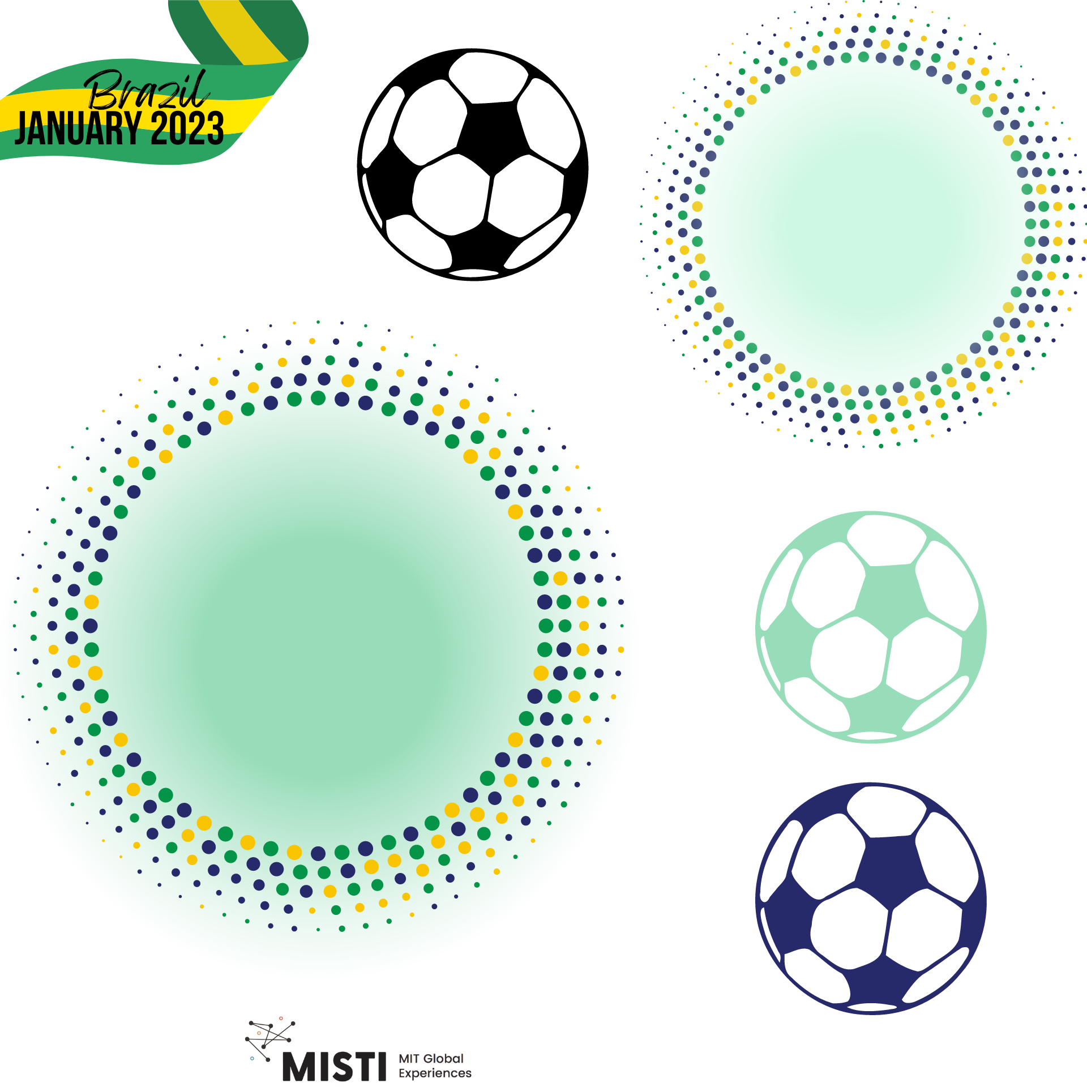
Preventing Concussions
Notes:
Semana da ciência da bola de futebol e materiais

Slide 2
Concussion basics
Preventing concussions is important for players and the future of the sport
When the brain hits the skull due to impact, acceleration (inertia), or large vibrations (explosions, blasts)
They are a very big risk in football
Image of soccer players going for a header and colliding
Image of brain motion during concussion

Slide 3
How to avoid concussions?
Many sports have adapted to prevent concussions during play
Helmets, rule changes, etc.
What about football?
Encouraging exercises that strengthen the neck
Concussion headgear
Lots of science
Images of sports players wearing helmets

Slide 4
Avoiding concussions in football
One idea for football could be to provide players with head protection, like in other sports.
But there are design considerations:
Weight, because football players need to be able to run, jump and dribble
Material, because not everything holds well!
Comfort, so that players don't have to change the way they play
Image of potential head gear that could be used for soccer

Slide 5
Concussion bands
Some companies are already manufacturing technology to protect against concussions in football using special composite materials..
Composites: Hybrid materials made from several different parts
These materials often have properties of several different materials, which makes them more useful
What properties should concussion straps have?
Image of soccer player wearing a concussion band

Slide 6
Concussion band properties
Lightweight - Weight can vary from 50 g to 200 g
Comfortable - Memory Foam that adapts to the shape of the body
Impact Resistant - Uses a special coated fabric that reduces acceleration and slows down impacts
Deflects and disperses force away from the head
Stylish - Comes in different colors for players to express some identity!
Image of the array of different concussion bands available

Slide 7
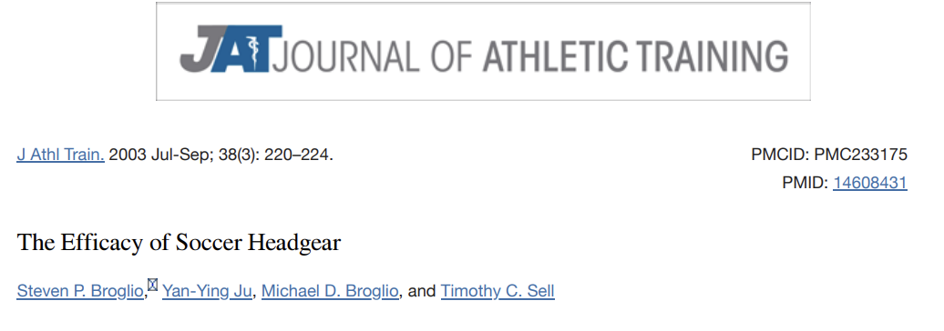
Efficacy of soccer headgear
There is a published scientific paper testing the effectiveness of football bands!
Scientists are concerned about keeping football players safe – and their work could prevent more concussions in the future!
Insert plots showing effectiveness from the referenced paper

Slide 8
Nobody wants a concussion!
Images of soccer players wearing headgear while playing

Slide 9
Works Cited
https://www.ncbi.nlm.nih.gov/pmc/articles/PMC233175/

